Slide 1
Sequence
Notes:
LO:
I can use logical reasoning to explain how some simple algorithms work.
To know that an algorithm is a set of instructions.
To create simple algorithms to make a rocket move.
Resources
Template: Y1Template1
Example: Y1Example1
Video: just2easy.com/vids/j2code/Y1video1

Slide 2
Algorithm
Sequence
Notes:
Introduce students to key vocabulary for this lesson:
Algorithm: An unambiguous procedure or precise step-by-step guide to solve a problem or achieve a particular objective.
Sequence: “When we sequence things, we arrange them in a particular order. Sequence-based algorithms are made from a precise set of instructions.”

Slide 3
A sequence is when we arrange something in a particular order. Sequence-based algorithms are made from a precise set of instructions.
Notes:
Remind students about the importance of sequence in computing/coding.
In sequence-based algorithms, such as a recipe to bake a cake, the order of many (though not all) of the steps is crucial. Similarly, most programming languages are based on a series of statements to sequentially process. The outcome of a program will depend not only on the constituent commands but their order.

Slide 4
Notes:
Remind the students about the various types of sequence.
You may want to point out the brush your teeth sequence you made last week.

Slide 5
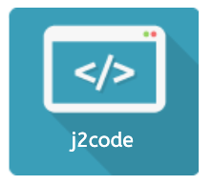
Notes:
Purpose
To introduce the use of sequence in j2code Turtle.
Learning objective By the end of this tutorial children should be able to:
I can use logical reasoning to explain how some simple algorithms work.
To know that an algorithm is a set of instructions.
To create simple algorithms to make a rocket move.

Slide 6
Notes:
Introduction
Show the example. Discuss what is happening as the rocket (sprite) moves. (Draw the children's attention to the instructions on the left.)
Reinforce the ideas of the concepts algorithm, sequence and code.
Ask your students these questions?
Q. How can we get the rocket to the orange planet? (Click the forward and turn arrows)
Q. What do the green and red pencil buttons do? (Pen up and pen down)
Children discuss and share ideas.

Slide 7
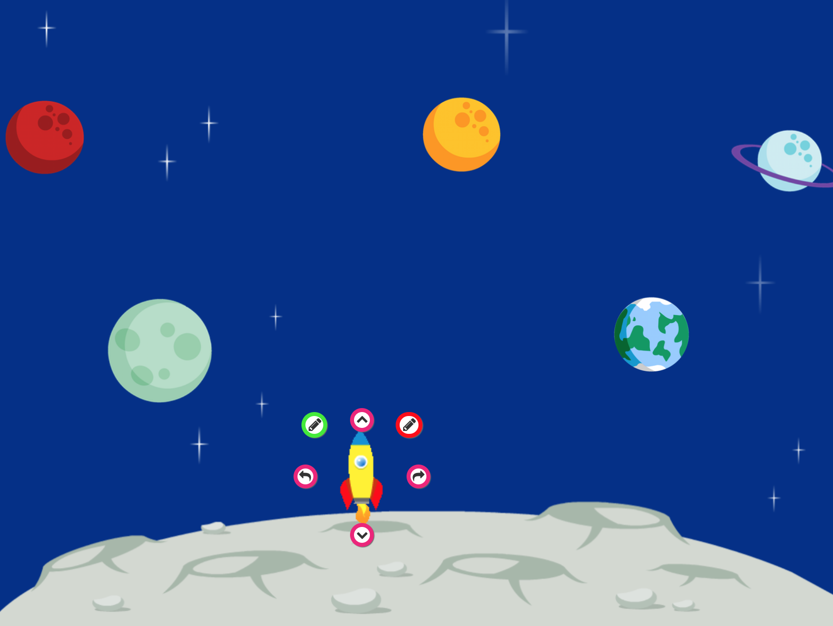
Notes:
Main Activities
Task 1: Using the space template have a go at making the rocket move to different planets. Experiment with pen up and pen down. Look at the code that appears in the box.
Stop the class and allow children to share what they have done. Discuss any problems.
Task 2: With pen down, make the rocket visit each planet in turn and return to base.

Slide 8
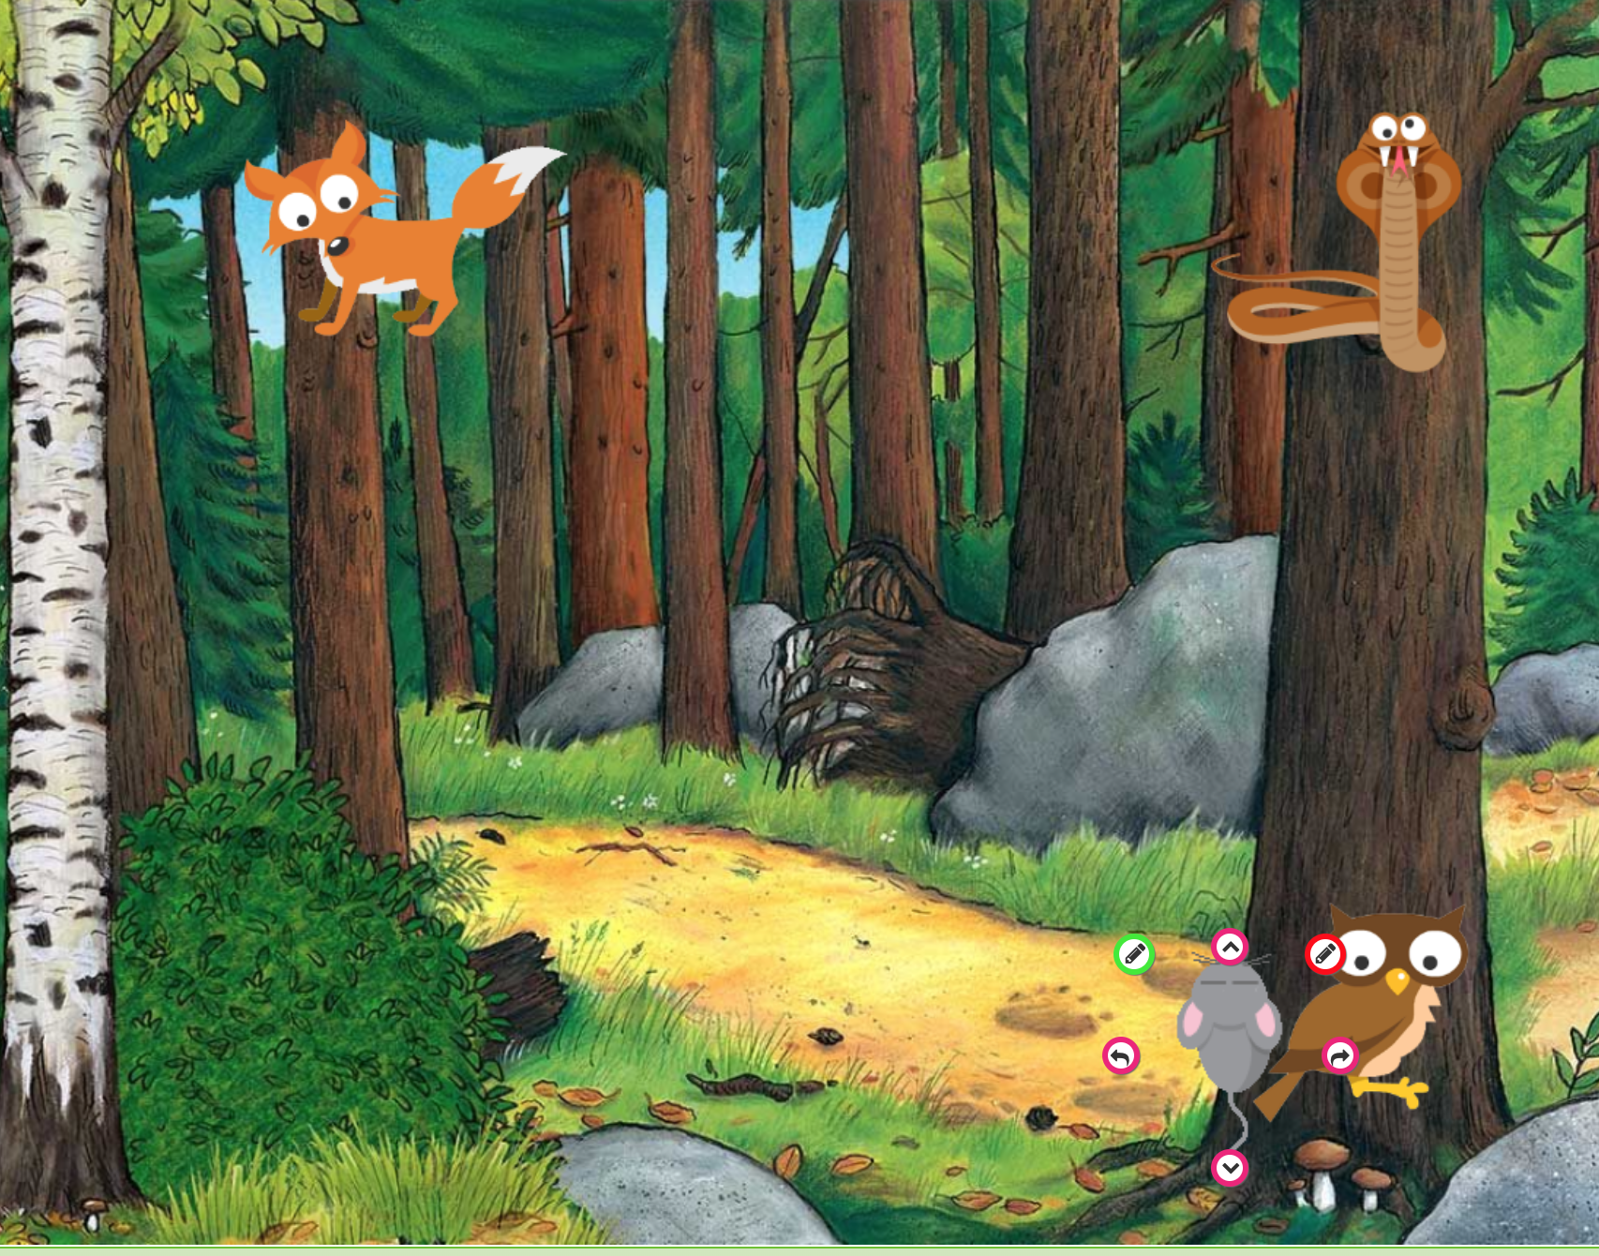
Notes:
Challenge:
Children choose two or more rockets to visit different planets at the same time. (Use the + button, select a second sprite and drag it to a new start position.)
See if students can explore changing the sprite to fit a different theme or topic.

